Slide 1

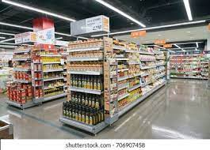
ATLIQ SALES AND PROMOTION ANALYSIS
DOMAIN:FMCG(SALES/PROMOTIONS)
CODEBASICS CHALLENGE #9
About
AtliQ Mart is a retail giant with over 50 supermarkets in the southern region of India.
All their 50 stores ran a massive promotion during the Diwali 2023 and Sankranti 2024 (festive time in India) on their AtliQ branded products.
Now the sales director wants to understand which promotions did well and which did not so that they can make informed decisions for their next promotional period.

Slide 2



Objective
TASK : ANALYSING THE AFFECT OF PROMOTIONS ON SALES OF THE MART
TOOLS USED :
MY SQL - for gaining business insights from data
POWER BI-for preparing dashboard
EXCEL

Slide 3
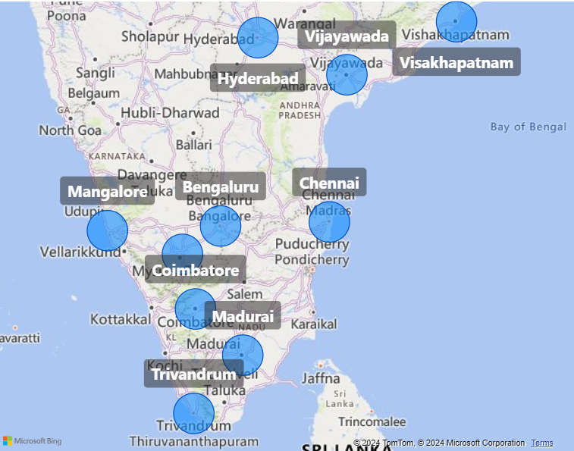
MARKET AREA OF MART
Hyderabad
Vijayawada
Vishakhapatnam
Chennai
Bengaluru
Mangalore
Coimbatore
Madurai
Trivandrum

Slide 4
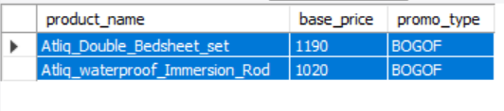
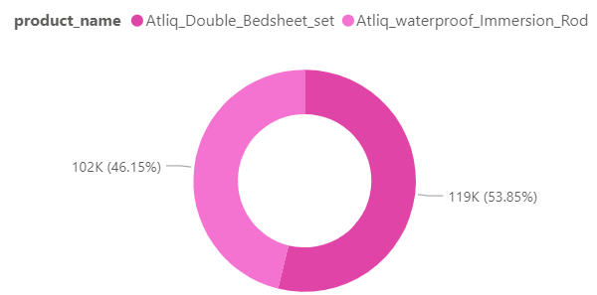
BUSINESS REQUESTS
Provide a list of products with base price greater than 500 and are featured in promo type “BOGOF”
Atliq_Double_Bedsheet_set and Atliq_waterproof_Immersion_Rod are the most expensive product that sold under "BOGOF" promo_type

Slide 5
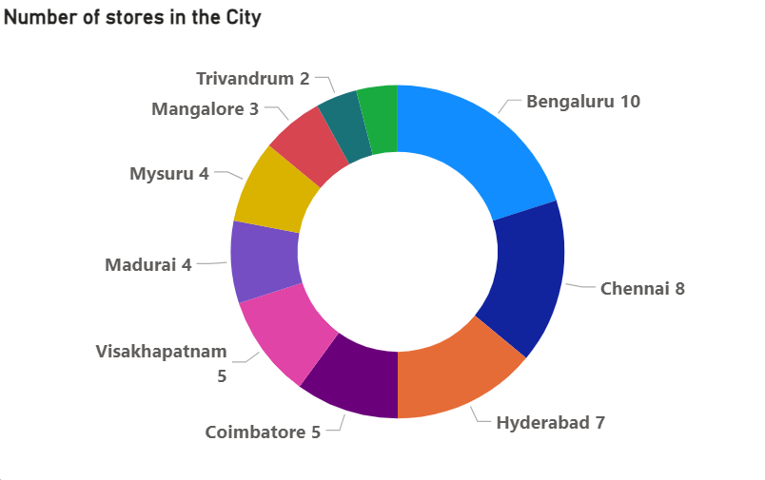
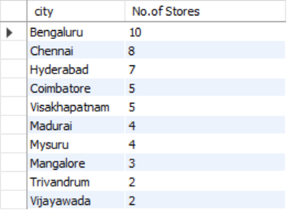
BUSINESS REQUESTS
Number of stores in each city
Bengaluru ,Chennai,Hyderabad contains more no.of stores

Slide 6
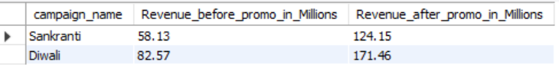
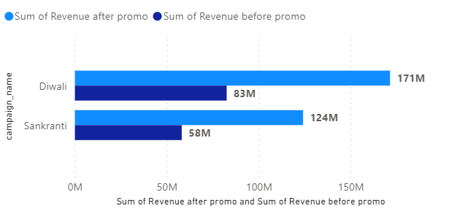
BUSINESS REQUESTS
Campaign wise revenue before and after promo
Diwali time promotions generates more revenue then Sakranti

Slide 7
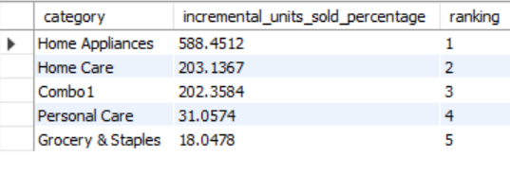
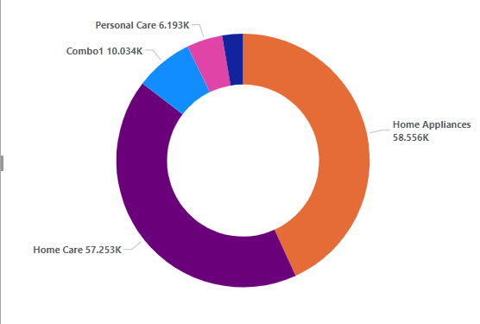
BUSINESS REQUESTS
Incremental Sold Units Percentage for each Product Category during Diwali Campaign
Home Appliances,Home care,Combo1 range shows a massive Increment in sold unit after promo whereas Grocery shows the least increase

Slide 8
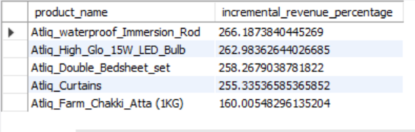
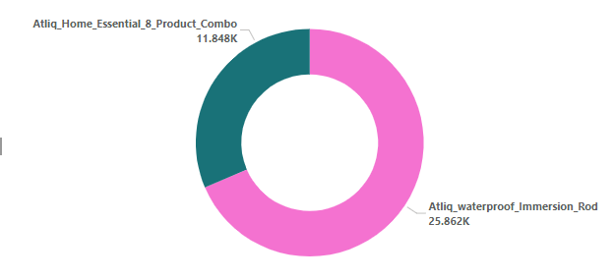
BUSINESS REQUESTS
Top 5 products listed by Incremental Revenue Percentage
Atliq_waterproog_immersion_rod ,LED_BULB shows the greatest spike in revenue after promo and Chakki_atta shows the least

Slide 9
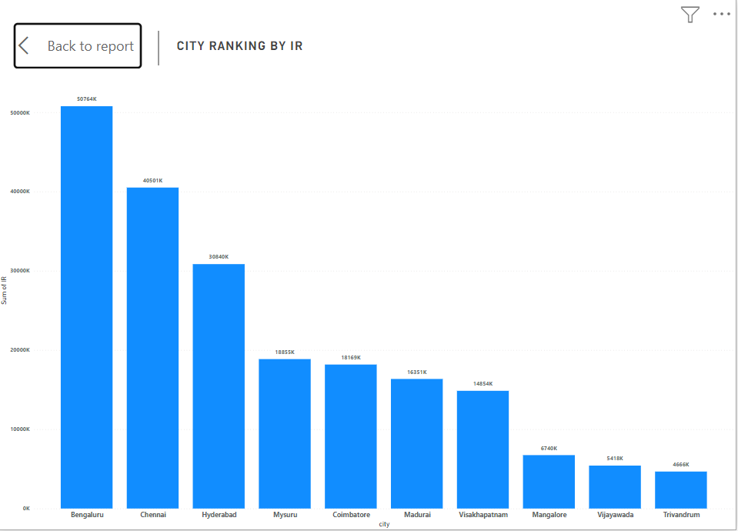
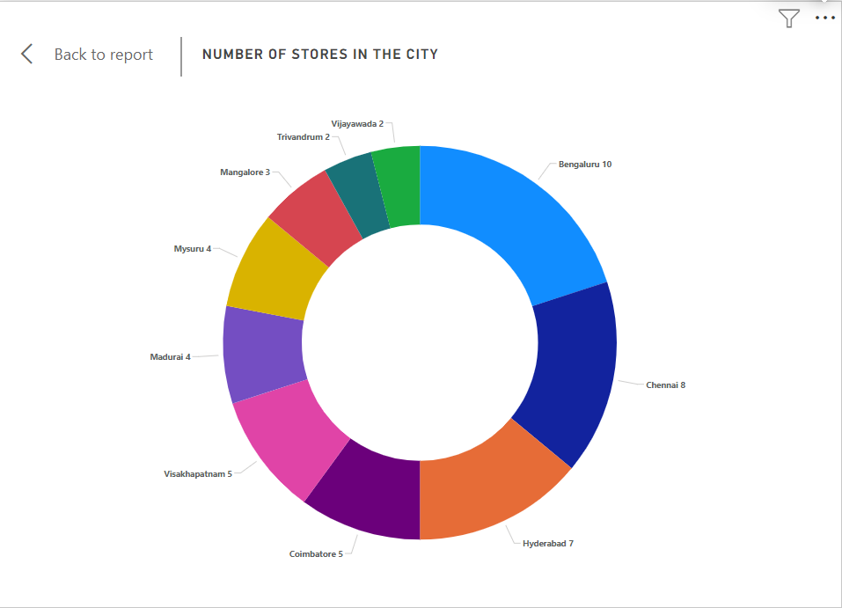
DASHBOARD INSIGHTS
Bengaluru,Chennai,Hyderabad are the top 3 cities that shows higher ranking for incremental revenue
Certainly ,the reason is that these cities have more numbers of stores present

Slide 10
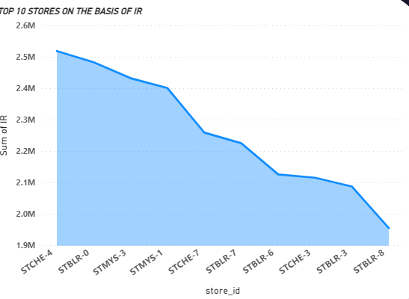
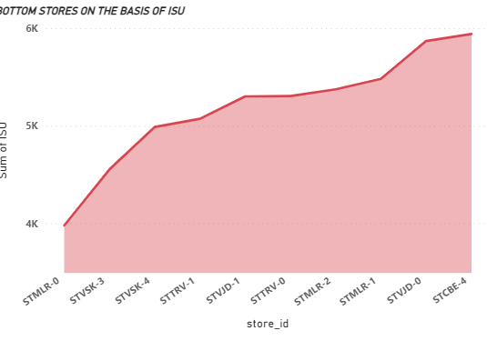
DASHBOARD INSIGHTS
STCHE-4 store is at the top when it comes to incremental revenue
STMLR-0 store is at the worst on the basis of incremental sold unit

Slide 11
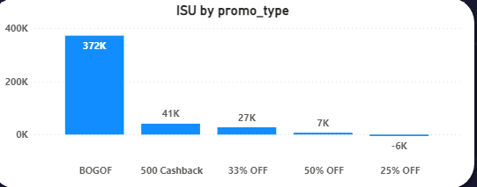
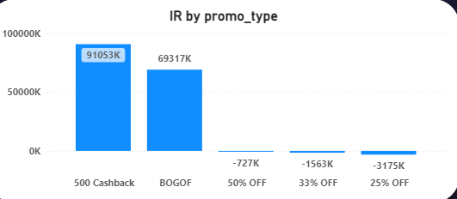
DASHBOARD INSIGHTS
BOGOF promo type works very well when it comes to incremental selling units
500 cashback promotype works well on incremental revenue
50%OFF,33%OFF,25%OFF these three are not performing well,causing revenue loss in the market ,so we may conclude that people are leaning more towards BOGOF and cashback offers rather then percent off promos

Slide 12
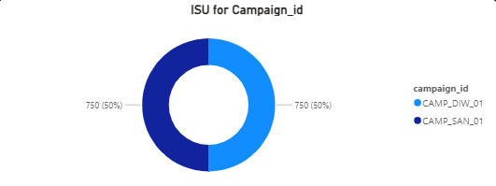
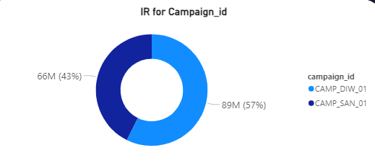
DASHBOARD INSIGHTS
When it comes to incremental selling unit both campaigns are working equally good
For incremental revenue Diwali campaign generates 89M revenue whereas Sankaranti generates 66M revenue

Slide 13
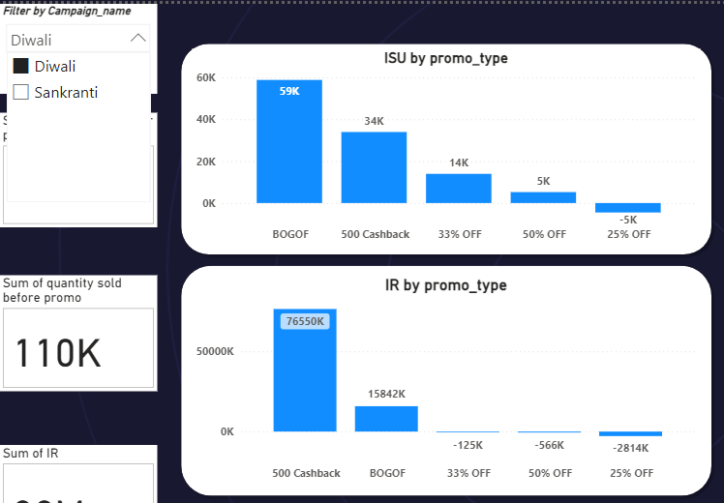
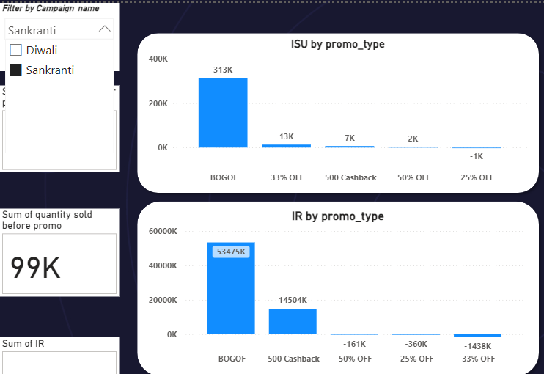
DASHBOARD INSIGHTS
During Diwali,500 cashback response is great for incremental revenue
During Sakranti,BOGOF works much better then 500 cashback for incremental revenue

Slide 14
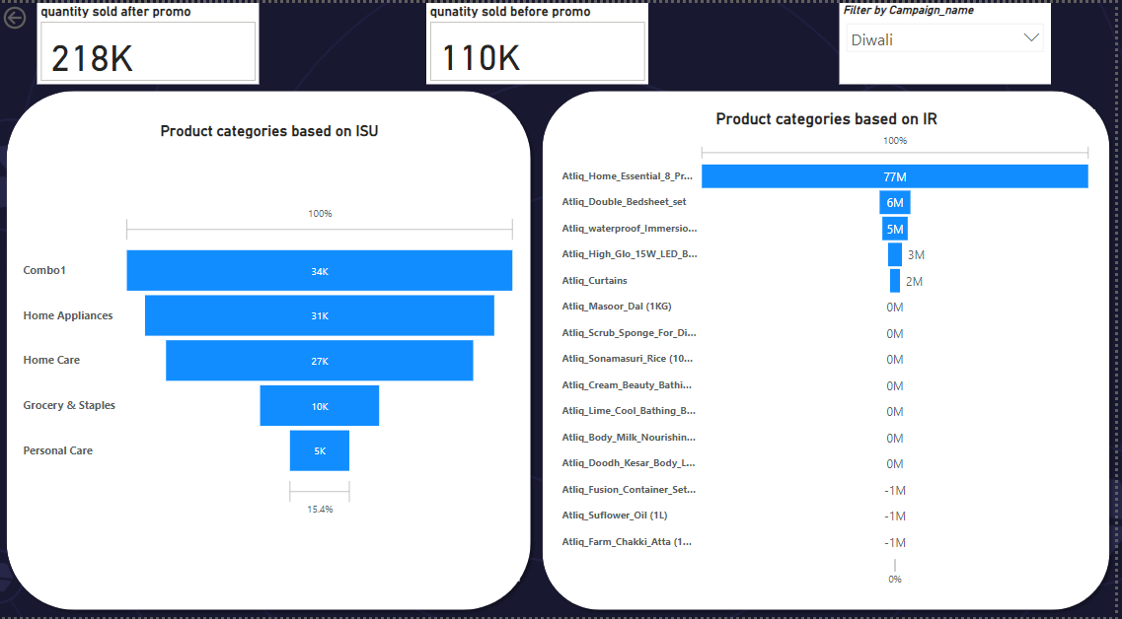
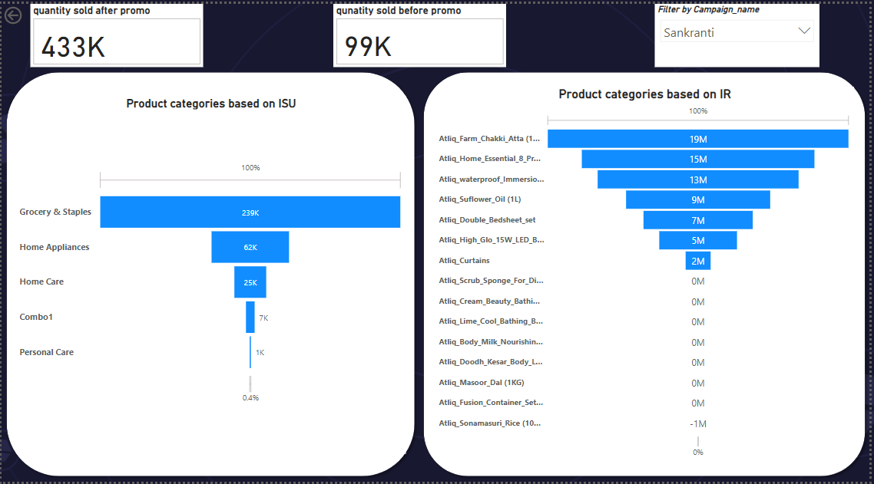
DASHBOARD INSIGHTS
During Diwali,Combo1 giving us the major jump out of all product categories
During Sakrant,Grocery and Staple category is doing great in market

Slide 15
CONCLUSION
BOGOF and CASHBACK promotypes are performing good in the market ,so we should allow these BOGOF and CASHBACK types discount on our products
For instance:we can give buy 4 get 1 free on products that are cheaper so people get more quantity,and 150,200 cashback on expensive products
For the products that are not performing that well as well as not going in loss also,we can create percentage off for those products

Slide 16
THANK YOU

